Slide 1
WinWin
Final Report Database Sys Presentation
By G14 Waterfall

Slide 2
Contents
Introduction
ER diagram and Schema diagram
Integrity Constraints
Indexing
Stored routines
Execution path
Implementation
Complex query
Notes:
Introduction ต้น
ER diagram and Schema diagram ทราย ธาม
Integrity Constraints ก้ำ
Indexing ก้ำ
Stored routines SP=ต้อง SF=เกรซ TG=ปุญญ์
Execution path ทราย
Implementation ปูน ธาม (ก้ำถ้าเขาถาม)
Complex query ปูน (หรือแล้วแต่สุ่ม)

Slide 3
Introduction

Slide 4

Introduction
Motorcycle taxi is the second most used transportation in Bangkok, besides MRT.
Other Ride-hailing applications reduced customer count of motorcycle taxis.
Digitalization of the motorcycle taxi system.

Slide 5
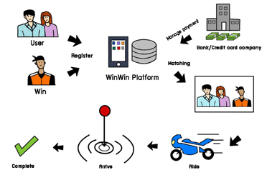
An Overview of The System
Both customers and riders will use the same application
However, their interface will be different based on their user type.
First, Customer and Rider register to the system.
The matchmaking system starts when the user selects
pick-up location and destination
rider preference
payment method
During the service, on motorcycle taxi side, there shall be an update (update status) to let the system know (that the motorcycle taxi has arrived, on the way to the destination, or arrived at the destination.)
After arriving at the destination, customer can review their rider.

Slide 6
ER diagram and
Schema diagram

Slide 7
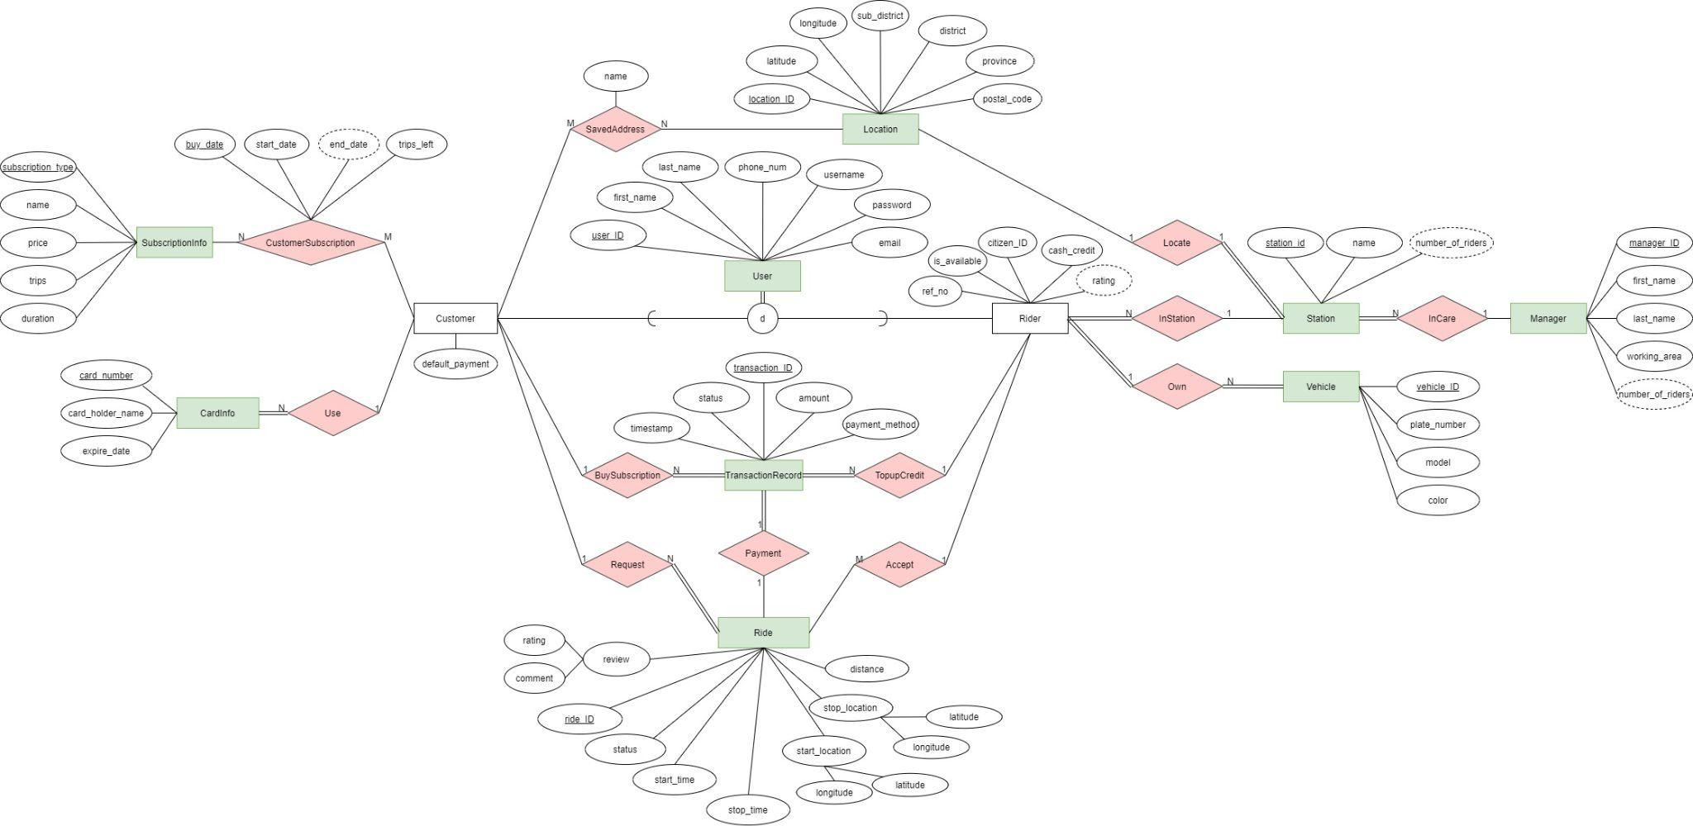
ER Diagram

Slide 8
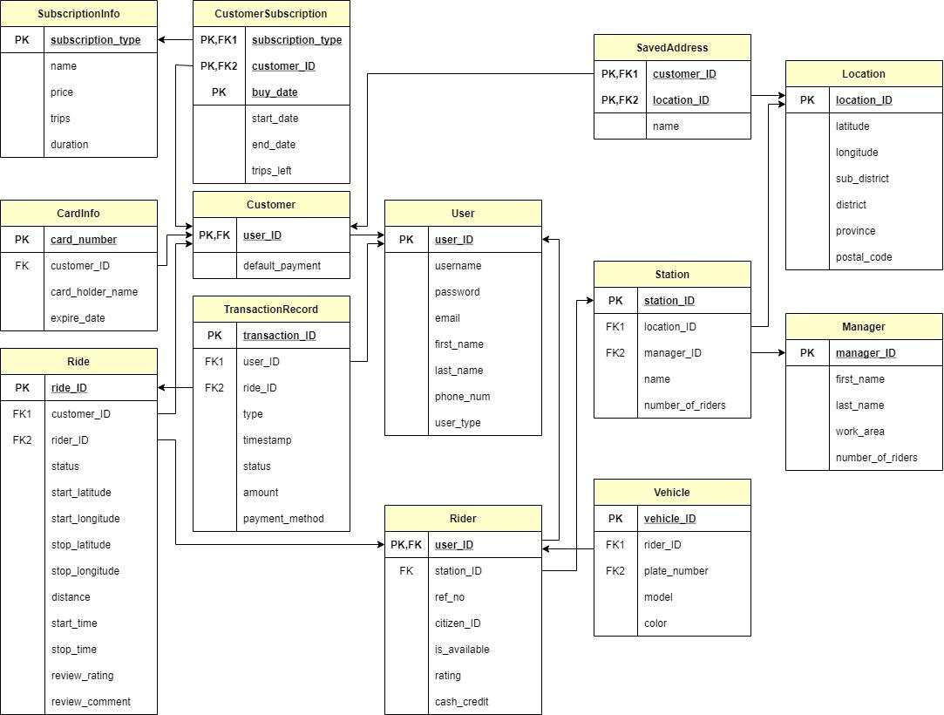
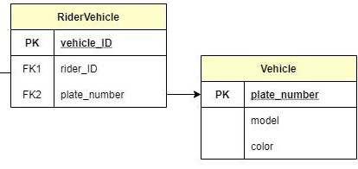
Schema Diagram and Normalization
Functional Dependencies
Vehicle :
vehicle_id→{rider_ID,plate_number}
plate_number→{model, color}
Other : PK→All

Slide 9
Document -Based Design Schema : Location
{ "type": "object", "bsonType": "object",
"title": "Location", "description": "Location of customer and station",
"required": [ "_id", "latitude", "longitude", "sub_district", "district", "province", "postal_code" ],
"properties": {
"_id": { "bsonType": "objectid" },
"latitude": { "bsonType": "double", "minimum": -90, "maximum": 90 },
"longitude": { "bsonType": "double", "minimum": -180, "maximum": 180 },
"sub_district": { "bsonType": "string", "minLength": 1, "maxLength": 50 },
"district": { "bsonType": "string", "minLength": 1, "maxLength": 50 },
"province": { "bsonType": "string", "minLength": 1, "maxLength": 50 }
},
"patternProperties": {
"postal_code": { "bsonType": "string", "minLength": 5, "maxLength": 5, "pattern": "(1-9)(0-9)*" } },
"minProperties": 8,

Slide 10
Document -Based Design Schema: Location
"dependencies": {
"locatedstation": {
"station": { "bsonType": "object" },
"numberofriders": { "bsonType": "int", "minimum": 0, "maxmum": 100 }
},
"customerSavedAddress": {
"bsonType": "array",
"items": {
"name": { "bsonType": "string", "minLength": 1, "maxLength": 50 },
"user_id": { "bsonType": "objectid" },
},
"minItems": 0,
"uniqueItems": true
}
}
}

Slide 11
Integrity Constraints
Notes:
ก้ำ

Slide 12
Domain Integrity
: Valid value of attribute
Relation Ride schema:
create table if not exists Ride(
ride_ID char(8) primary key,
customer_ID char(8),
rider_ID char(8),
status enum('matching','matched','cancelled','in_transit','arrived','paid','reviewing','completed') not null,
.
.
check(start_latitude >= -90 and start_latitude <= 90),
check(start_longitude >= -180 and start_longitude <= 180),
check(stop_latitude >= -90 and stop_latitude <= 90),
.
.
Notes:
ก้ำ

Slide 13
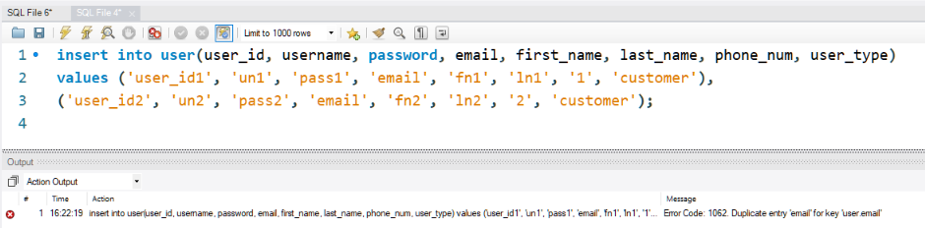
Domain Integrity : Unique attribute
Relation User schema:
create table if not exists User(
user_ID char(8) primary key,
username varchar(50) not null, password text not null,
email varchar(100) not null unique,
first_name varchar(50) not null, last_name varchar(50) not null,
phone_num char(10) not null, user_type enum('customer','rider') not null );
Notes:
ก้ำ

Slide 14
Domain Integrity : Delete operation
Relation Rider schema:
create table if not exists Rider(
user_ID char(8) primary key,
station_ID char(8) not null,
ref_no char(16) not null unique,
citizen_ID char(13) not null unique,
is_available boolean not null default true,
rating float,
cash_credit float not null default 0,
foreign key (user_ID) references User(user_ID) on update cascade on delete cascade,
foreign key (station_ID) references Station(station_ID) on update cascade on delete restrict,
check(rating >= 1 and rating <= 5 ),
check(cash_credit >= 0)
);
Notes:
ก้ำ

Slide 15
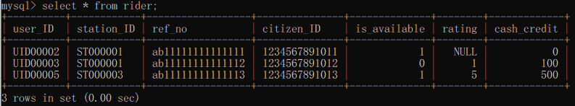
Domain Integrity: Delete operation
Execution and Results:
Notes:
ก้ำ

Slide 16
Indexing
Notes:
ก้ำ

Slide 17
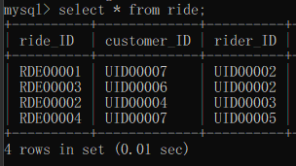
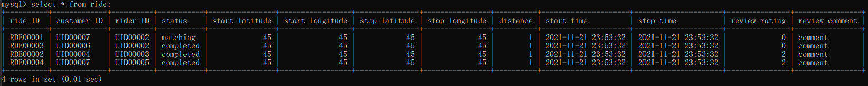
Indexing
Relation and Attributes
Ride <rider_ID, ride_ID, review_rating>
Index structure
Clustered B+ tree
Notes:
เนื่องจากเราต้องทำการอัพเดท rating ของ rider ใหม่ทุกครั้งที่ customer ทำการ review เข้ามา ทำให้เราต้องค้นหา records ใน ride ตาม rider_ID หลายครั้ง จึงทำ indexing โดยให้ rider_ID อยู่อันดับแรก และเนื่องจากเราต้องการคิด rating ตามจำนวน ride และด้วยข้อจำกัดของ MySQL การทำ Clustered index จำเป็นต้องทำบน search key ที่ unique และ not null จึงต้องเพิ่ม ride_ID เข้าไปด้วย (rider_ID ไม่ unique) นอกจากนี้การที่นำ rating มาทำ indexing ด้วยเพราะว่าในการคำนวณ rating ของ rider เราใช้แค่ column rating เพียง column เดียวในการหาค่า average rating ทำให้ไม่มีความจำเป็นจะต้องอ่านข้อมูลทั้ง record ออกมา ดังนั้น การนำ column rating มาทำ indexing ด้วยจึงทำให้ index นี้เป็นการทำ index แบบ index-only plans ซึ่งช่วยเพิ่มประสิทธิภาพในการ query มากขึ้น

Slide 18
Stored Routines
Stored Procedure
Stored Function
Trigger

Slide 19
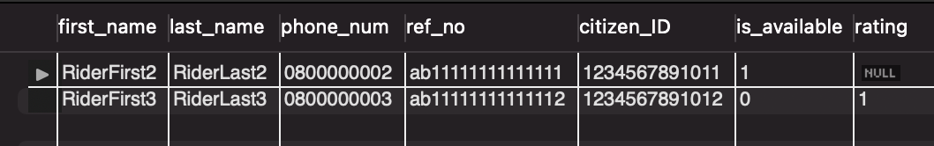
Stored procedures
: Get rider from station
DELIMITER $$
CREATE PROCEDURE GetRiderFromStation(IN stationName varchar(50))
BEGIN
SELECT U.first_name, U.last_name, U.phone_num, R.ref_no, R.citizen_ID, R.is_available, R.rating
FROM rider R natural join station S natural join user U
WHERE S.name = stationName;
END$$
DELIMITER ;

Slide 20
Stored procedures
: Update Rider Station
DELIMITER $$
CREATE PROCEDURE UpdateRiderStation(
IN i_user_ID CHAR(8),
IN i_station_ID CHAR(8))
BEGIN
DECLARE exit handler for sqlexception
Begin
Rollback;
Resignal;
End;
start transaction;
update Rider
set station_ID=i_station_ID
where user_ID = i_user_ID;
commit;
END$$
DELIMITER ;

Slide 21
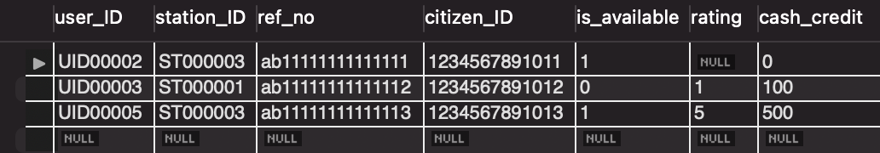
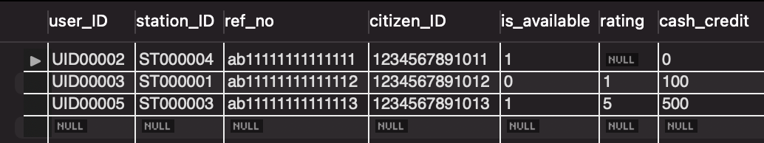
Stored procedures
: Update Rider Station
Before : Rider
After : Rider

Slide 22
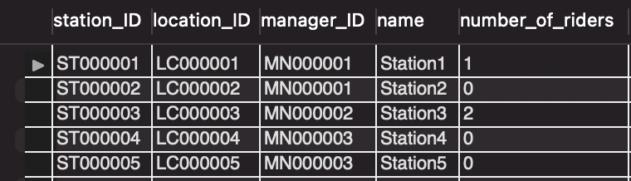
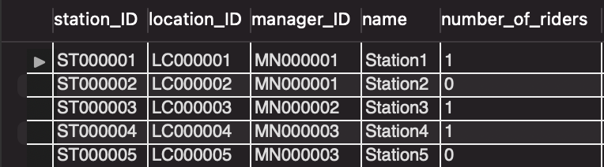
Stored procedures
: Update Rider Station
Before : Station
After : Station

Slide 23
Stored functions
: Price Calculation
DELIMITER $$
CREATE FUNCTION calcPrice(dist float)
RETURNS INT
DETERMINISTIC
BEGIN
DECLARE price INT;
DECLARE remDist float;
IF dist > 5 THEN
BEGIN
set remDist = dist - 5;
IF MOD(remDist,1) < 0.5 THEN set remDist = remDist - MOD(remDist,1);
ELSE set remDist = remDist - MOD(remDist,1) + 1;
END IF;
set price = (48 + remDist*12);
END;
ELSEIF (dist <= 5 AND dist > 2.5) THEN
BEGIN
set remDist = dist - 2.5;
IF MOD(remDist,1) < 0.5 THEN set remDist = remDist - MOD(remDist,1);
ELSE set remDist = remDist - MOD(remDist,1) + 1;
END IF;
set price = (30 + remDist*6);
END;
ELSEIF (dist <= 2.5 AND dist > 0) THEN
set price = 30;
END IF;
RETURN (price);
END $$
DELIMITER ;

Slide 24


Stored functions
: Price Calculation
Example & Result

Slide 25
Stored functions
: Calculate Total Ride Time
DELIMITER $$
CREATE FUNCTION calcRideT(startT datetime, stopT datetime)
RETURNS time
DETERMINISTIC
BEGIN
DECLARE totalT INT;
set totalT = abs(timediff(stopT, startT));
RETURN (totalT);
END $$
DELIMITER ;

Slide 26
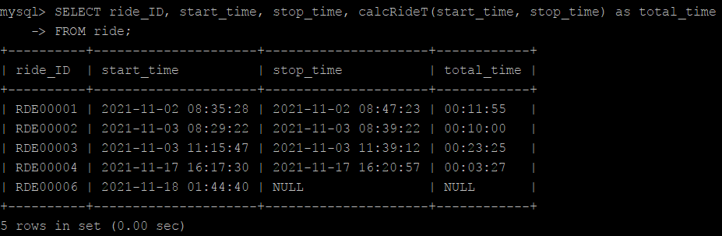
Stored functions
: Calculate Total Ride Time
Example & Result

Slide 27
Triggers: Update Number of riders
DELIMITER //
CREATE TRIGGER updateNumberOfRiders
AFTER update
ON rider for each row
BEGIN
IF NEW.station_ID != OLD.station_ID THEN
BEGIN
DECLARE new_station_manager char(8);
DECLARE old_station_manager char(8);
select manager_ID into new_station_manager
from station
where station_ID = NEW.station_ID;
select manager_ID into old_station_manager
from station
where station_ID = OLD.station_ID;
update station
set number_of_riders = number_of_riders + 1
where station_ID = NEW.station_ID;
update station set number_of_riders = number_of_riders - 1
where station_ID = OLD.station_ID;
IF new_station_manager != old_station_manager THEN
BEGIN
update manager set number_of_riders = number_of_riders + 1
where manager_ID = new_station_manager;
update manager set number_of_riders = number_of_riders - 1
where manager_ID = old_station_manager;
END;
END IF;
END;
END IF;
END //
DELIMITER ;

Slide 28


Triggers: Update Number of riders
Execution and Result
Call UpdateRiderStation(‘UID00002’, ‘ST000004’)
BEFORE: Rider
AFTER: Rider

Slide 29
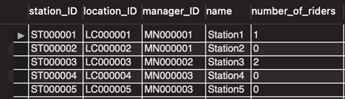
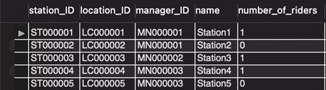
Triggers: Update Number of riders
BEFORE: Station
AFTER: Station

Slide 30
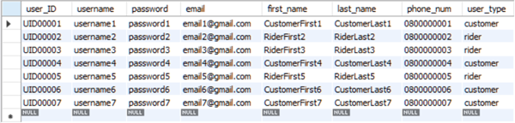
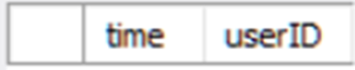
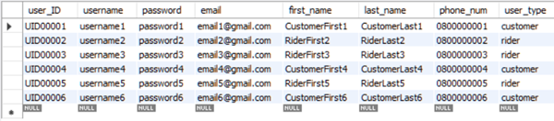

Triggers: Delete Account Log
CREATE TABLE TriggerTime(time datetime NOT NULL, userID char(8) NOT NULL);
CREATE TRIGGER deleteAccountLog
AFTER DELETE ON User FOR EACH ROW
INSERT INTO TriggerTime VALUES(NOW(), OLD.user_ID);
Execution and Result
DELETE * FROM user WHERE user_ID = 'UID00007';
Before
After

Slide 31
Execution Path

Slide 32
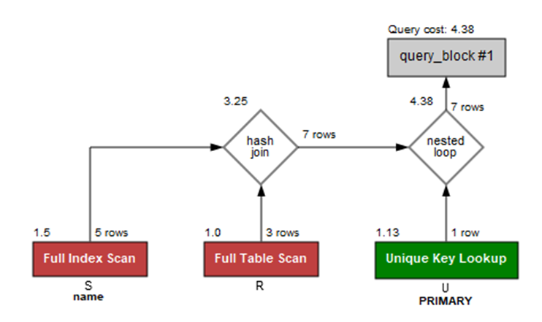
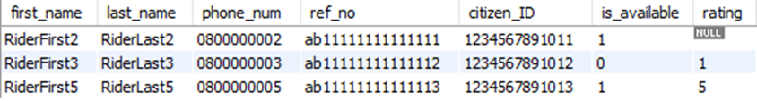
Execution Path
SELECT U.first_name, U.last_name, U.phone_num, R.ref_no, R.citizen_ID, R.is_available, R.rating
FROM rider R natural join station S natural join user U
WHERE S.name = 'Station1' or R.user_ID = 'UID00005';

Slide 33
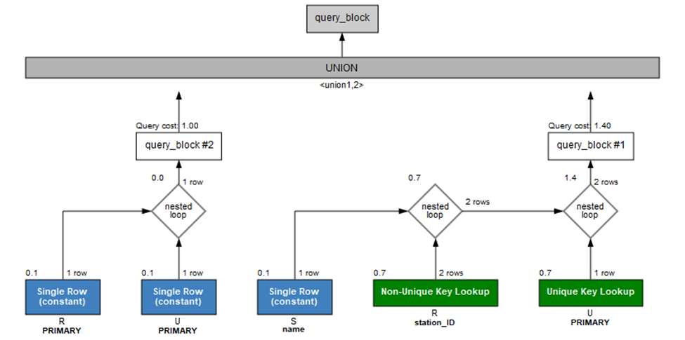
Execution Path
(SELECT U.first_name, U.last_name, U.phone_num, R.ref_no, R.citizen_ID, R.is_available, R.rating
FROM rider R, station S, user U
WHERE U.user_ID=R.user_ID and R.station_ID=S.station_ID and S.name = 'Station1')
UNION
(SELECT U.first_name, U.last_name, U.phone_num, R.ref_no, R.citizen_ID, R.is_available, R.rating
FROM rider R, user U
WHERE U.user_ID=R.user_ID and R.user_ID='UID00005');

Slide 34
Implementation
and Complex Query

Slide 35
G14 Waterfall - Members
6230123921 Thitaree Setwipattanachai
6230252121 Tarm Kalavantavanich
6231301421 Kanokpich Chaiyawan
6231304321 Kittipong Deevee
6231307221 Jirawat Kusalangkurwat
6231333521 Nopdanai Sayamnet
6231353021 Raviporn Akekunanon
6231372021 Atiwat Deepo

